Slide 1

CS 4320: Software Design Semester Project Final Presentation
Team 7: Rayne Guinta, Jeffrey Simonoff, and Jessie Meredeth
CS 4320-001
Dr. Armin Moin
TA Aryan Padiyal
CC0 1.0
CC0 1.0 Universal
Permission to be published on UCCS website

Slide 2
Project
Topic: Train Booking and Tracking
Path: Plan-Driven
Description: This is a Greenfield Project focused on checking the attendance of passengers that have purchased a ticket.
Who: Train Transport Companies, Staff, and Passengers
Problem: Insufficient visibility on passenger attendance, leading to issues such as overbooking and unaccounted passengers.

Slide 3
License (Open-Source)
MIT License Copyright (c) [2024] [Rayne Guinta, Jeffrey Simonoff, Jessie Meredeth] Permission is hereby granted, free of charge, to any person obtaining a copy of this software and associated documentation files (the "Software"), to deal in the Software without restriction, including without limitation the rights to use, copy, modify, merge, publish, distribute, sublicense, and/or sell copies of the Software, and to permit persons to whom the Software is furnished to do so, subject to the following conditions: The above copyright notice and this permission notice shall be included in all copies or substantial portions of the Software.
THE SOFTWARE IS PROVIDED "AS IS", WITHOUT WARRANTY OF ANY KIND, EXPRESS OR IMPLIED, INCLUDING BUT NOT LIMITED TO THE WARRANTIES OF MERCHANTABILITY, FITNESS FOR A PARTICULAR PURPOSE, AND NONINFRINGEMENT. IN NO EVENT SHALL THE AUTHORS OR COPYRIGHT HOLDERS BE LIABLE FOR ANY CLAIM, DAMAGES OR OTHER LIABILITY, WHETHER IN AN ACTION OF CONTRACT, TORT OR OTHERWISE, ARISING FROM, OUT OF OR IN CONNECTION WITH THE SOFTWARE OR THE USE OR OTHER DEALINGS IN THE SOFTWARE.

Slide 4
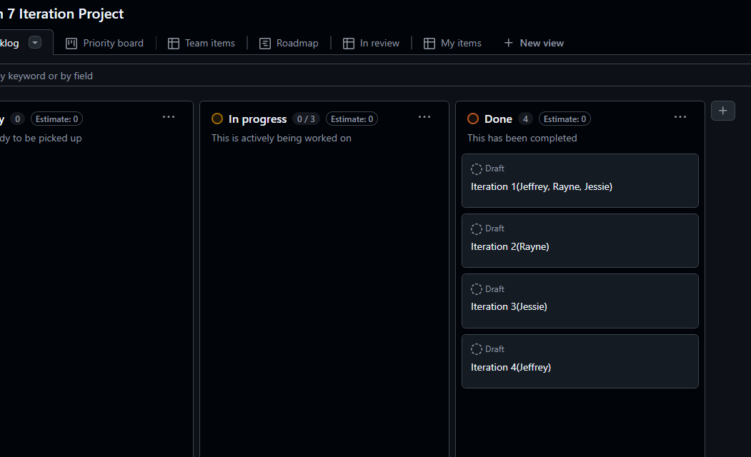

Our Project – GitHub Link
https://github.com/JSimonoff-operator/CS4320Team72024

Slide 5
Related work
Aviation Tracking Systems
GitHub: awesome-adsb
Public Transit
Real-Time Transit Apps(Google/Apple Maps)
Apple Maps (Proprietary System): Simple Map
Google Maps (Proprietary System): Geolocation
Booking Apps
GitHub: Train-Ticket-Reservation-System

Slide 6
Unique Selling Point (USP)
The unique selling point of our project is using machine learning, the app will suggest optimal seats (e.g., window/aisle) based on travel history or preferences and provide alternate routes based on current train schedules, delays, and user location. While still prioritizing the features from most booking applications, such that we have a focus on not overbooking, security, safety, and comfort of all passengers and crew members.
By comparison to our competition of existing train transportation applications, such as Google Maps and Apple Maps, we provide a unique system that allows for staff and customer flexibility on high-end train transportation.

Slide 7
Options to Build Upon
GPS for Train Tracking
Wi-Fi and Bluetooth Beacons (Apple iBeacon and Google Eddystone)
Open Trip Planner and General Transit Feed Specification
OpenCV (Security)
Cloud Infrastructure (AWS IoT or Google Cloud IoT)
Why Not Reuse?
Proprietary Systems
Limited Focus Solutions
Limited Flexibility

Slide 8
Use Cases (Functional) and Quality Attributes (Non-Functional)
Use Cases | Description
UC-1: Login | Use an algorithm to check whether the user is a customer or staff member.
UC-2: Monitor Network Status | Use an algorithm to check the network's overall status.
UC-3: Check Seating Availability | Utilize a data-focused algorithm to check for available seats.
UC-4: Payment Processing | Use a data-processing algorithm to interpret a user customer's payment methods.
UC-5: Assign Passenger Seating | Upon selecting a seat, a customer's account will be attributed to the selected seat, where data is then stored.
UC-6: GPS Tracking | Track train locations in real-time to provide accurate updates to account for departure and arrival times.
Quality Attributes | Attributed Use Cases | Description
QA-1: Security | UC-1 (Login), UC-4 (Payment Processing) | The system must ensure secure user authentication and protect sensitive user data.
QA-2: Performance | UC-1 (Login), UC-3 (Check Seating Availability), UC-4 (Payment Processing), UC-6 (GPS Tracking) | User login and seating availability checks should be completed in real-time or within milliseconds.
QA-3: Availability | UC-2 (Monitor Network Status) | The system must have high uptime, especially for network monitoring, with fast detection of network outages.
QA-4: Reliability | UC-2 (Monitor Network Status), UC-3 (Check Seating Availability), UC-6 (GPS Tracking) | The system should consistently monitor the network and seating availability, detecting any failures and providing notifications for resolution.

Slide 9
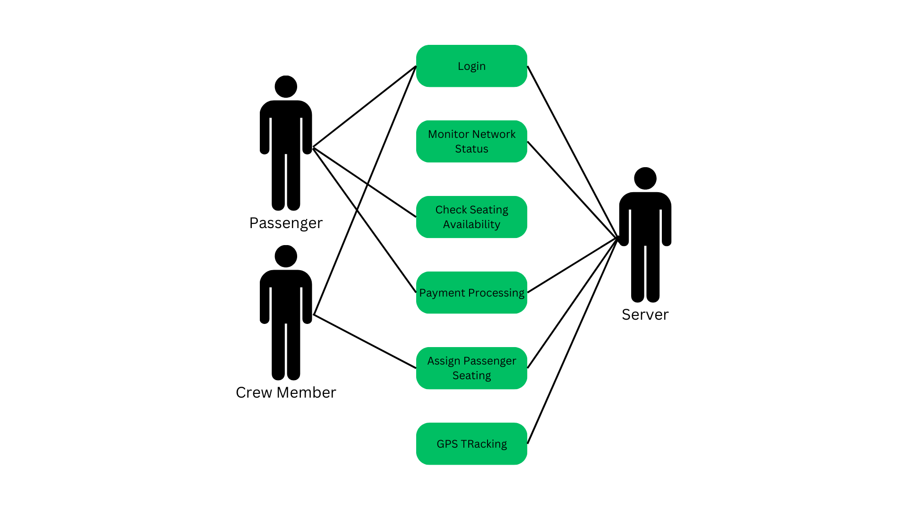
Use Case Diagram

Slide 10
Concerns and Constraints
CRN-1: User Authentication
Description: Proper authentication processes are crucial to distinguish between customers and staff. Weak authentication may lead to unauthorized access to sensitive areas of the system.
CRN-2: Network Dependency
Description: The system's reliance on network connectivity for features like monitoring and payment processing raises concerns about what happens during network outages or disruptions.
CON-1: User Training and Support
Description: Staff and customers may require training to effectively use the system. Lack of adequate training could lead to misuse or failure to utilize system features.
CON-2: Budget Limitations
Description: Financial constraints may limit the resources available for system development, maintenance, and upgrades, potentially affecting performance and security.

Slide 11
Work Breakdown
Rayne
Conceptual Data Sketches
Architectural View and Viewpoint Sketches
Documented Views and Viewpoints
2nd Iteration
Jeffrey
Initial Idea
Element and Responsibilities Chart
Initial Table Iterations in Documentation
4th Iteration
Jessie
Communications and Planning
Design Decisions
Decision and Iteration Flows in Documentation
3rd Iteration

Slide 12
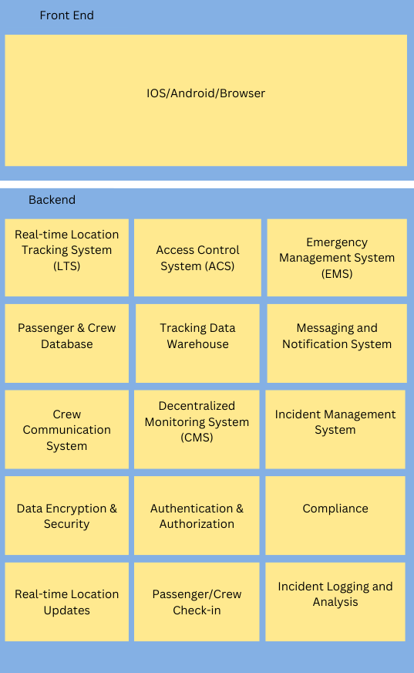
1st Iteration Reference Architecture

Slide 13
1st Iteration Design Decisions
Design Decision 1: GPS and Bluetooth Beacons
Rationale: GPS is highly effective for tracking objects outdoors, but GPS by itself is not effective inside the train due to poor signal. To fix this each train company should install Bluetooth beacons in the carriages to have precise positioning.
Design Decision 2: Decentralized Cloud-Based Data Storage and Processing
Rationale: Allows real-time data from GPS and Bluetooth to be processed and stored in multiple accessible locations, consisting of passenger, platform, and train-focused servers.
Design Decision 3: Data Privacy Protocols
Rationale: Minimizing data access, by implementing a Role-Based Access Control.

Slide 14
1st Iteration Recorded Design Decisions
Main contributing factors
Decentralized Server Coordination
Data collection of passenger and staff attendance
Communications between passenger, platform operative, and train staff servers

Slide 15
Element | Responsibility
Presentation Client Side | This layer contains modules that control user interaction and use case control flow.
API Gateway | Manages requests from clients, routing them to appropriate microservices while providing a single-entry point.
User Authentication Module | Handles user registration, login, and token management to ensure secure access to the system.
Train Attendance Microservice | Manages attendance records, including check-ins and check-outs, providing CRUD operations for users.
Decentralized Data Storage | Uses a distributed ledger or decentralized database to store attendance data securely and transparently.
Notification System | Sends alerts and notifications to users regarding attendance updates or reminders via email or push notifications.
Analytics Engine | Gathers data from attendance records to generate insights and reports for users and administrators.
Admin Dashboard | Provides administrative tools for managing users, viewing attendance metrics, and system health monitoring.
Integrations Module | Facilitates connections to third-party services, such as calendar apps or transport systems for enhanced user experience.
Security Layer | Ensures data encryption, secure communication, and protection against common vulnerabilities.
Passenger Server | Handles passenger application module to operate client(passenger)-server communications, including ticket storage.
Train Server | Handles train staff client-server communications, including passenger records. Communicates to the passenger and operative servers.
Operative Server | Handles platform operative client-server communications, often communicating with the train server on passenger capacity.

Slide 16
Progress of 1st Iteration
Not Addressed | Partially Addressed | Completely Addressed | Design Decisions Made During the Iteration
 | UC-1 |  | Separate user roles between passenger and staff have been identified. Login functionality is utilized in selected related work.
 | UC-2 |  | Selected technologies through related work and backend systems address this use case.
UC-3 |  |  | No relevant decisions made as it is vital to examine what systems will be utilized.
UC-4 |  |  | No relevant decisions made as it is important to address how communications and technologies will be used with payment processors.
 | UC-5 |  | Selected reference architecture supports modules that can utilize this functionality.
UC-6 |  |  | No relevant decisions made.
 | QA-1 |  | Separate user roles in login have been addressed, but payment processing has yet to be implemented.
 | QA-2 |  | Login has been addressed, but not payment processing or seating availability
 | QA-3 |  | Selected backend system technologies acknowledge this attribute.
 | QA-4 |  | Network status monitoring has been partially addressed with this attribute, while payment processing still requires a decision.
CRN-1 |  |  | No relevant decisions made.
 | CRN-2 |  | A decentralized server algorithm ensures the security of some data that passengers and staff may have had access to while online. Additionally, there will be dedicated staff for each server.
 | CON-1 |  | Concern is partially addressed through the idea of a proper UI, which will allow passenger and staff users to utilize the system in a simple but efficient manner. The technology will be open source to address the issue of a user interface. Training will allow for smoother processes between all users.
CON-2 |  |  | No relevant decisions made.

Slide 17
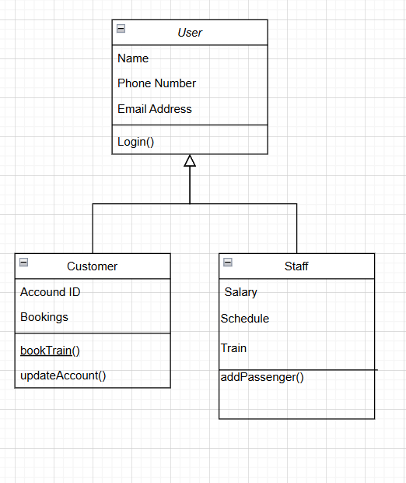
Class Diagram

Slide 18
Component Diagram

Slide 19
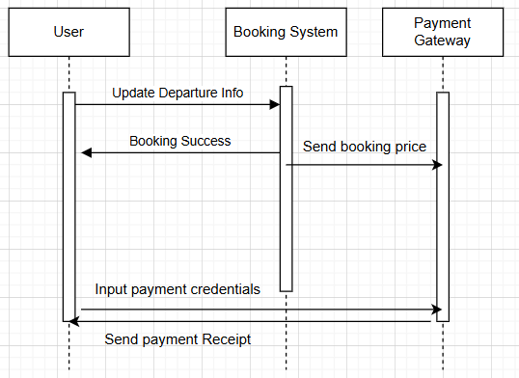
Sequence Diagram

Slide 20
State Diagram

Slide 21

2nd Iteration: Monitoring and Train Tracking Design
Problem: The system lacks reliable real-time network monitoring and train tracking features that optimize performance.
Objective: Design/plan the functionalities to monitor the network status and track trains while addressing performance and reducing network dependency concerns.

Slide 22
Requirements Analysis for UC-2
Functional Requirements: The system needs to perform health checks every 5 seconds and a system technician needs to be notified by email or SMS within 2 minutes of a failure.
Non-Functional Requirements: Response time for system health check needs less than 1 second. And system uptime target at 99%.

Slide 23
Requirements Analysis for UC-6
Functional Requirements: Track the train's position and update it at intervals of 1 second or less and notify emergency services within 30 seconds of emergency detection.
Non-Functional Requirements: The location accurately depicts the train within 10 meters and the success rate of delivery is greater than 95%.

Slide 24
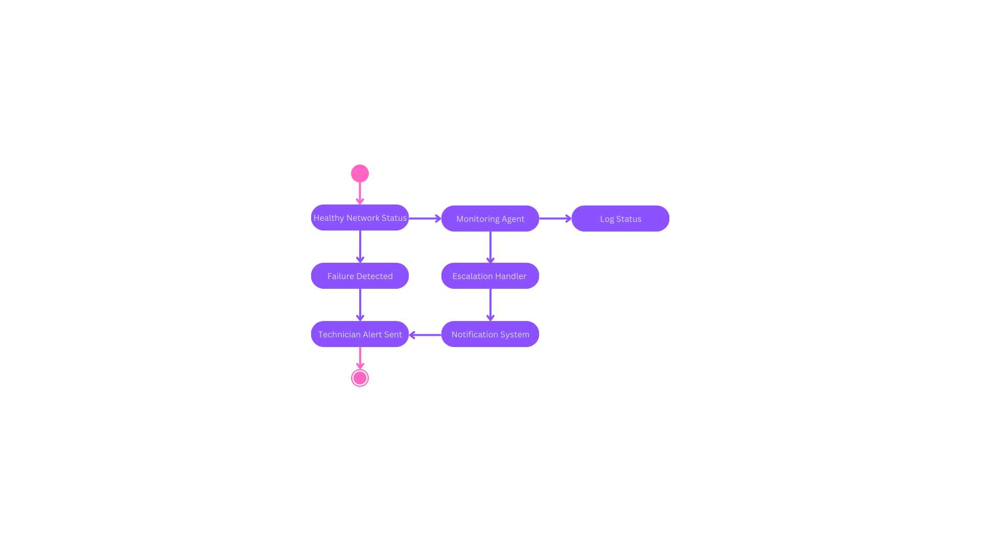
State Diagram

Slide 25
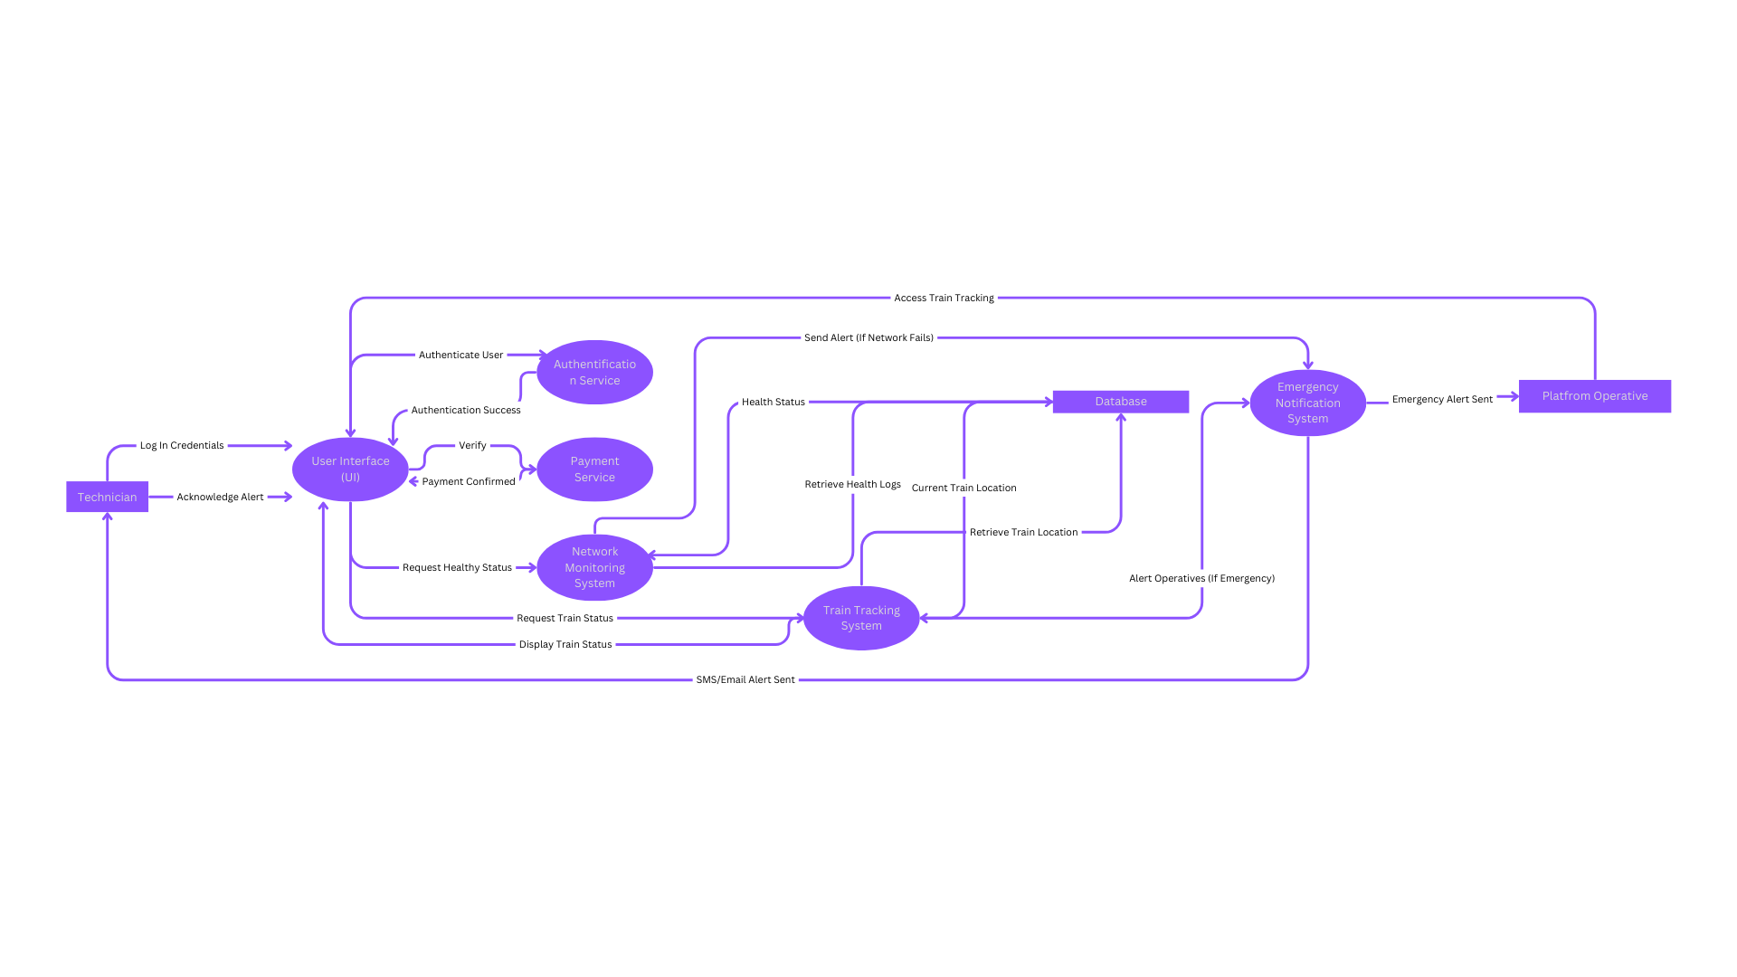
System Architecture

Slide 26
Progress of 2nd Iteration
Defined the objective of the iteration for monitoring the network status and GPS tracking.
Defined the requirements for UC-2 and UC-6.
A state diagram is made to show the flow of the network system.
Created a system architecture diagram to show the system's flow for log-in, payments, network monitoring, train tracking, and emergency notifications.

Slide 27
Progress of 2nd Iteration
Not Addressed | Partially Addressed | Completely Addressed | Design Decisions Made During the Iteration
 | UC-1 |  | Separate user roles between passenger and staff have been identified. Login functionality is utilized in selected related work.
 |  | UC-2 | Defined requirements for network status and explained with detailed system architecture.
UC-3 |  |  | No relevant decisions made as it is vital to examine what systems will be utilized.
UC-4 |  |  | No relevant decisions made as it is important to address how communications and technologies will be used with payment processors.
 | UC-5 |  | Selected reference architecture supports modules that can utilize this functionality.
 |  | UC-6 | Defined Requirements with and created a system architecture to address train tracking.
 | QA-1 |  | Separate user roles in login have been addressed, but payment processing is still missing key aspects.
 | QA-2 |  | Login has been addressed along with payment processing, but seating availability has not been.
 | QA-3 |  | Selected backend system technologies acknowledge this attribute.
 | QA-4 |  | Network status monitoring has been partially addressed with this attribute, while payment processing still requires a decision.
CRN-1 |  |  | No relevant decisions made.
 |  | CRN-2 | Addressed the issue of network status dependency affecting the rest of the networks and systems.
 | CON-1 |  | Concern is partially addressed through the idea of a proper UI, which will allow passenger and staff users to utilize the system in a simple but efficient manner. The technology will be open source to address the issue of a user interface. Training will allow for smoother processes between all users.
CON-2 |  |  | No relevant decisions made.

Slide 28

3rd Iteration: User Login and Payment Processing Design
Problem: The current system lacks proper user authentication and a reliable payment processing system.
Objective: Ensure a seamless and secure login experience for users while distinguishing between staff and customer roles. Secure and streamline payment processing while addressing network dependency issues.

Slide 29
Requirement Analysis for UC-1
Functional Requirements
Non-Functional Requirements
The system must verify the existence of a user's account upon login attempt. Must differentiate between staff and user roles
Must be responsive and redirect user within 2 seconds under normal conditions. System must handle multiple simultaneous login attempts

Slide 30
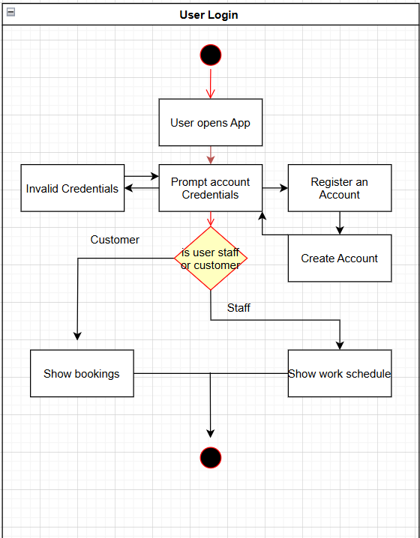
Activity Diagram

Slide 31
Requirement Analysis for UC-4
Functional Requirements
The system must accept multiple payment methods, including credit cards, debit cards, and digital wallets. The system must verify the validity of the provided payment method with the user’s bank.
Non-Functional Requirements
The system must ensure 99.9% uptime for the payment processing service. The system must encrypt all sensitive payment data using industry-standard encryption methods

Slide 32
Progress of 3rd Iteration
Login and Security Measures have been Planned for by using ML-Driven Fraud Detection.
Multiple payment methods have been Accounted for by utilizing a Payment Gateway.
Payments are Properly Verified by Allowing Confirmation with Various Banks.
Systems are Operated with Efficiency for the Tasks of Logging In and Paying.

Slide 33
Progress of 3rd Iteration
Not Addressed | Partially Addressed | Completely Addressed | Design Decisions Made During the Iteration
 |  | UC-1 | Machine learning-based security enhancements detect and flag suspicious login patterns to reduce unauthorized access. Distinction between staff and user roles are clear and easy to distinguish.
 |  | UC-2 | Defined requirements for network status and explained with detailed system architecture.
UC-3 |  |  | No relevant decisions made as it is vital to examine what systems will be utilized.
 |  | UC-4 | Introduced ML-driven fraud detection to identify irregular transaction patterns and enhanced encryption for secure bank communications.
 | UC-5 |  | Selected reference architecture supports modules that can utilize this functionality.
 |  | UC-6 | Defined Requirements with and created a system architecture to address train tracking.
 | QA-1 |  | Separate user roles in login have been addressed, but payment processing is still missing key aspects.
 | QA-2 |  | Login has been addressed along with payment processing, but seating availability has not been.
 | QA-3 |  | Selected backend system technologies acknowledge this attribute.
 | QA-4 |  | Network status monitoring has been partially addressed with this attribute, while payment processing still requires a decision.
 |  | CRN-1 | Login authorization between staff and customer has been addressed.
 |  | CRN-2 | Addressed the issue of network status dependency affecting the rest of the networks and systems.
 | CON-1 |  | Concern is partially addressed through the idea of a proper UI, which will allow passenger and staff users to utilize the system in a simple but efficient manner. The technology will be open source to address the issue of a user interface. Training will allow for smoother processes between all users.
CON-2 |  |  | No relevant decisions made.

Slide 34

4th Iteration: Customer Seating Assignments, Interactivity, and Constraints
Problem: Current train tracking applications lack flexibility for customers and staff, and budgets appear to be a concern.
Objective: Plan/Design program functionality to check seating availability and assign customers to seats, while considering application interactional and budgetary constraints.

Slide 35
Requirement Analysis for UC-3
Functional Requirements
Non-Functional Requirements
The system must examine seating availability in regular 15 minute intervals, and validate the status of each individual seat.
The chart accurately depicts seating availability, where the system can perform these tasks with low latency and can utilize its checks during peak usage times of ~1000 users.

Slide 36
Requirement Analysis for UC-5
Functional Requirements
The system needs to assign the seat to the customer, where a notification via email or text should be sent to the user about their selected seat within 5 minutes, and if the seat is taken, the system should prevent the user from selecting it.
Non-Functional Requirements
Seat assignment can function 99.9% of the time, especially in peak usage times of 1000 users, and the system is able to assign a seat and update seating availability within 2 seconds in real time.

Slide 37
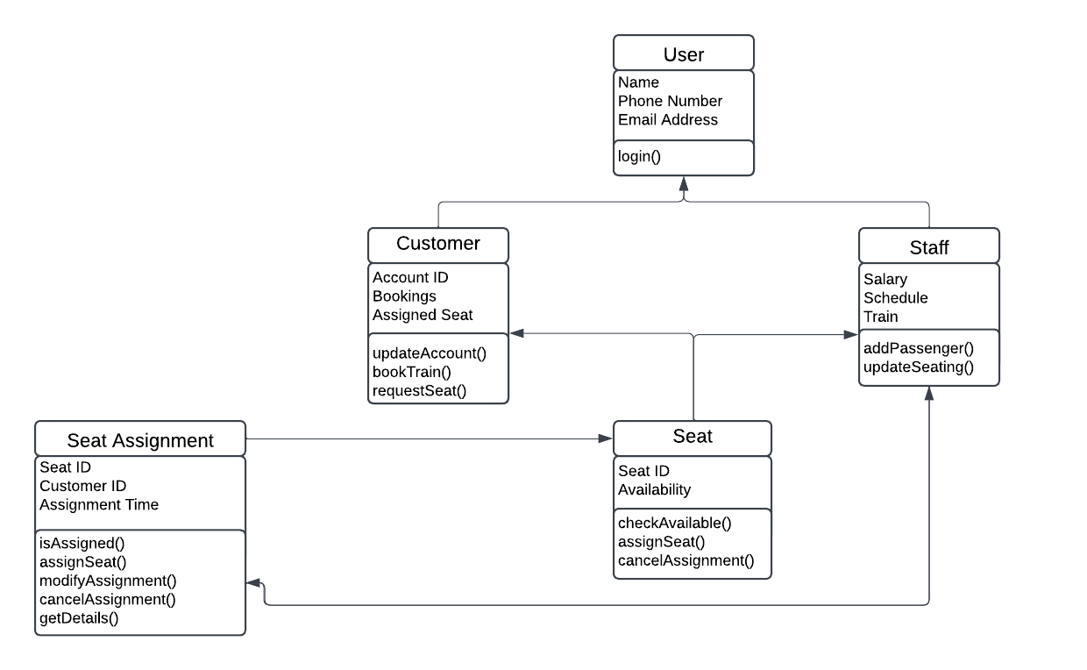
Iteration 4 – Class Diagram

Slide 38
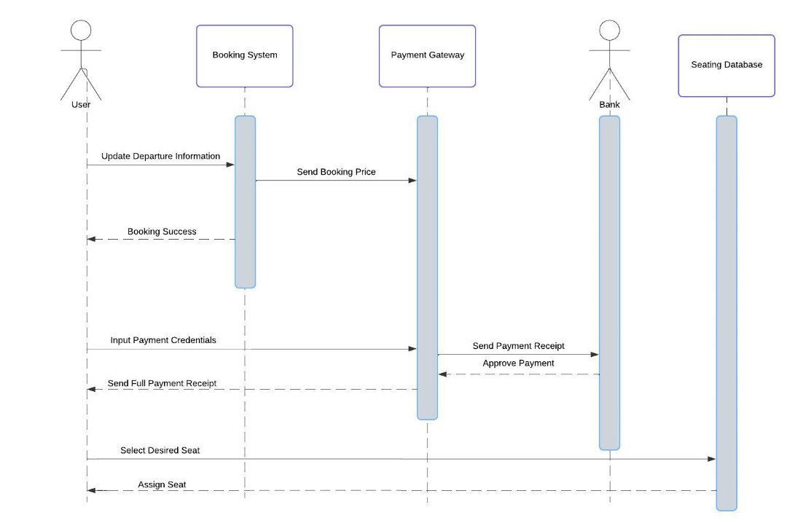
Iteration 4 – Sequence Diagram

Slide 39
Progress of 4th Iteration
Seating Selection and Assignment Systems have been Properly Planned for.
All Quality Attributes have been Recognized and Accounted for.
Budgetary and Training Constraints have been Addressed in Full.

Slide 40
Progress of 4th Iteration
Not Addressed | Partially Addressed | Completely Addressed | Design Decisions Made During the Iteration
 |  | UC-1 | Machine learning-based security enhancements detect and flag suspicious login patterns to reduce unauthorized access. Distinction between staff and user roles are clear and easy to distinguish.
 |  | UC-2 | Defined requirements for network status and explained with detailed system architecture.
 |  | UC-3 | Systems utilize seating availability and allow for optimal decisions during peak assignment times. Seat selection discrepancies are handled by storing a user into a specific seat.
 |  | UC-4 | Introduced ML-driven fraud detection to identify irregular transaction patterns and enhanced encryption for secure bank communications.
 |  | UC-5 | Selected reference architecture supports modules that can utilize this functionality. Seat assignments can operate at peak times in real time, where a customer is placed into a seat, where a proper system is in place to avoid a second user from taking an already assigned seat.
 |  | UC-6 | Defined Requirements with and created a system architecture to address train tracking.
 |  | QA-1 | Separate user roles in login have been addressed, and payment processing functionality has been planned for
 |  | QA-2 | Login has been addressed along with payment processing, as well as seating availability.
 |  | QA-3 | Selected backend system technologies acknowledge this attribute. Network status is monitored for both train tracking emergencies and customer seating times.
 |  | QA-4 | Network status monitoring has been partially addressed with this attribute, where payment processing has also been addressed.
 |  | CRN-1 | Login authorization between staff and customer has been addressed.
 |  | CRN-2 | Addressed the issue of network status dependency affecting the rest of the networks and systems.
 |  | CON-1 | Concern is addressed through the idea of a proper UI, which will allow passenger and staff users to utilize the system in a simple but efficient manner. The technology will be open source to address the issue of a user interface. Training will allow for smoother processes between all users.
 |  | CON-2 | Budgetary constraints have been addressed through the usage of AWS and runtime functionality.

Slide 41
Work Breakdown - Timeline
Iteration 1 (Oct. 1 – 29)
Contributors – Jessie, Rayne, Jeffrey
Iteration 2 (Oct. 30 – Nov. 14)
Contributor - Rayne
Iteration 3 (Nov. 15 – 24)
Contributor – Jessie
Initial Planning (Sept. 5 - 30)
Contributors – Jessie, Rayne, Jeffrey
Iteration 4 (Nov. 25 – Dec. 2)
Contributor – Jeffrey
Final Revisions (Dec. 3 – 4)
Contributors – Jessie, Rayne, Jeffrey
Reflection (Dec. 5)
Contributors – Jessie, Rayne, Jeffrey

Slide 42
Course Content and Our Project
Our project goes hand and hand with scenario 1 from lab 1, which is the greenfield project in a well understood domain.
A system to track passengers is nothing new, in fact, it’s a well explored topic, but our system allows for more effective tracking than other systems. For this reason, our project similarly relates to scenario 1 from lab 1.
We've also included UML diagrams that we have discussed throughout the course as well to help design out project.

Slide 43
Questions?

